Slide 1
An Introduction to Generalized Linear Mixed Models
Evan M. Adams and Beth Ross
8/5 – 8/6/2021

Slide 2

General Linear Mixed Models
What are we mixing again?

Slide 3
Effect Type Definitions
There are actually many definitions! Here are somewhat useful ones:
Fixed
Often a variable that you want to make inference on directly
You estimate the parameter directly through maximum likelihood and no other parameters are involved
Random
Often a latent variable that describes the population
You estimating the parameters via shrinkage

Slide 4

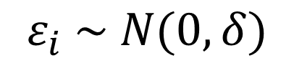
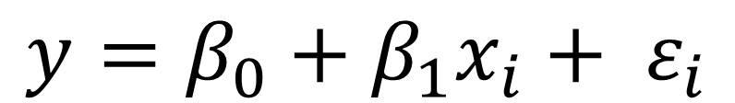
GLMs
$$y=β_{0}+β_{1}x_{i}+ ε_{i}$$
Two Main Components
Linear regression
Mean-variance assumption
$$ε_{i} \sim N(0, δ)$$

Slide 5
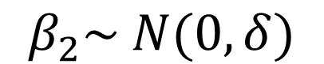
GLMMs
$$y=β_{0}+β_{1}x_{i}+β_{2}z_{i}+ ε_{i}$$
$$β_{2}\sim N(0, δ)$$
$$ε_{i} \sim N(0, δ)$$
Three Main Components
Fixed effects
Random effects
Mean-variance assumption

Slide 6
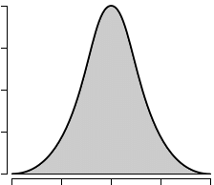
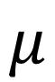
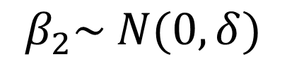
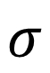
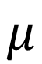
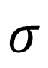
Random Effects
$$σ$$
Represents a sample from a larger reference population
$$μ$$
Random effect mean
$$σ$$
Random effect variance
In practice, we often set the mean of the random effect to zero and estimate the variance
$$β_{2}\sim N(0, δ)$$
$$μ$$

Slide 7
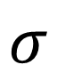
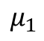
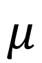
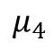
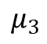
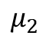
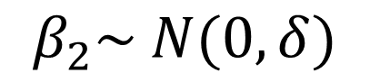
Random Effects Example
$$μ$$
4 levels of a random effect
The aggregation of the individual effects allow us to estimate the effect variance
$$β_{2}\sim N(0, δ)$$
Each level of the random variable also has an estimate of uncertainty
$$μ_{1}$$
$$μ_{2}$$
$$μ_{3}$$
$$μ_{4}$$
$$σ$$
The estimate for the suite of random levels

Slide 8
Why do we like random effects?
Information sharing across levels of the effect
Estimates gravitate toward the mean of the normal distribution governing the effect
Random levels with higher sample size can be estimated in an unbiased matter
They are efficient
Handle complicated study designs or effects with multiple levels without using many degrees of freedom in the model
They can account for complex study designs or clear biases in data collection

Slide 9
Why do things go sideways?
Lack of independence in your random variable levels
Too few levels to properly estimate the variance
Confounded/correlated with other random or fixed effects
Maximum likelihood convergence is harder to achieve
It can be difficult to assess the fit of the random variance term

Slide 10
Issues with inference
Spurious relations can be common
These models are hard to fit and there could be issues that are difficult to spot at first glance
p-values for random effects can be hard to interpret
p-values in general are already highly arbitrary
You need to estimate your degrees of freedom in a random effect and there is debate over what is the appropriate way to handle that
Assessing goodness-of-fit
Marginal and conditional assessments of SSE GoF estimators
Essentially with or without the random effect
Estimates can be difficult to compare across models
Degrees of freedom are tricky so AIC-based model selection requires assumptions
Models are fit with REML which violates assumptions if its included in AIC

Slide 11

Example: revisiting the tick abundance data set with an eye to individual effects

